Slide 1
Security Mindset
Lesson Introduction
Why is cyber security important?
How do we understand cyber security?
What needs to be done to address cyber security?

Slide 2
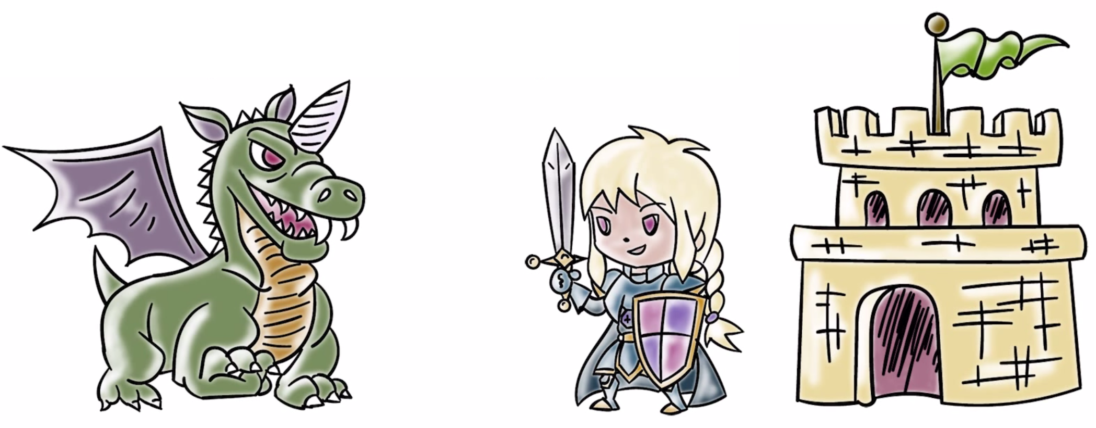
Why Cyber Security?
We worry about security when...
...we have something of value and there is a risk it could be harmed.

Slide 3
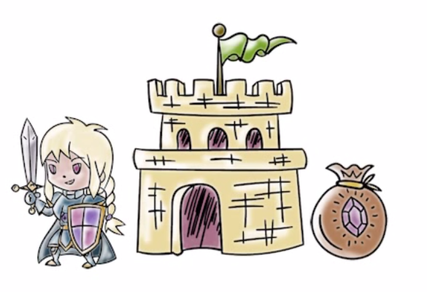
Why Cyber Security?
Individuals store a lot of sensitive data online
if stolen, criminals can profit from it
Societies rely on the internet
nefarious parties could profit by controlling it

Slide 4
Why Cyber Security?
Smart Grids rely on cyber systems
whoever controls the grid controls the community infrastructure
Business and government proprietary information is often stored on the internet
unauthorized access could be economically or politically disasterous

Slide 5

Security Impact Quiz
Each of these organizations suffered data breaches of more than 30,000 records. Check the companies that you have patronized:
Home Depot
Facebook
Ebay
Apple
JP Morgan Chase
Snapchat
Anthem Target
Twitter
UPS
Mozilla Nintendo

Slide 6
Cyber Assets at Risk
How do we understand the risk to our online information and systems?
We need to develop a security mindset
What is the security mindset?
Threats, vulnerabilities and attacks

Slide 7
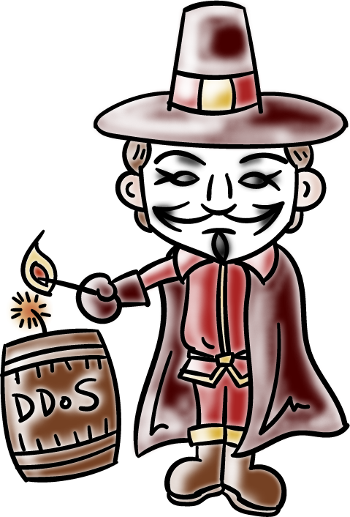
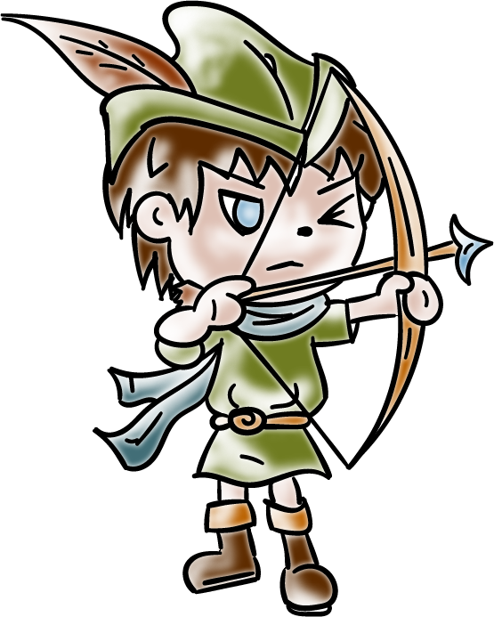
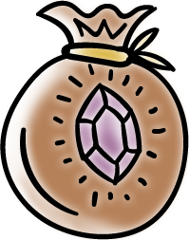
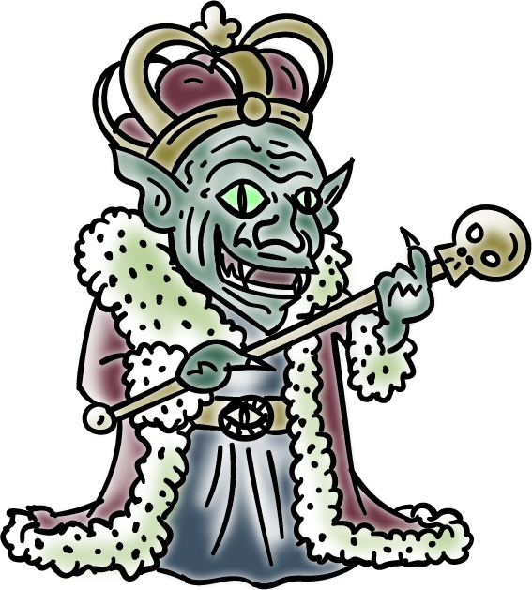
Cyber Assets at Risk
Threat source: who wants to do harm to us in our online lives
Hacktivists: activists who do not like something you are or something you do.
Cybercriminals: want to profit from our sensitive data for financial gain.
Nation-states: Countries do it for political advantage or for espionage.

Slide 8
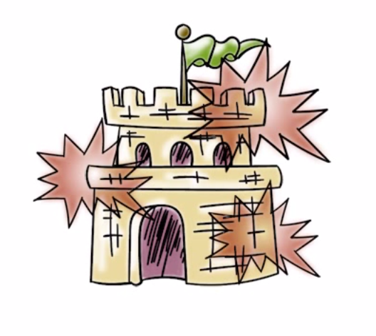
Vulnerabilities and Attacks
threat actors exploit vulnerabilities to launch attacks
attacks lead to compromises or security breaches
vulnerabilities can be found in software, networks, and humans.

Slide 9
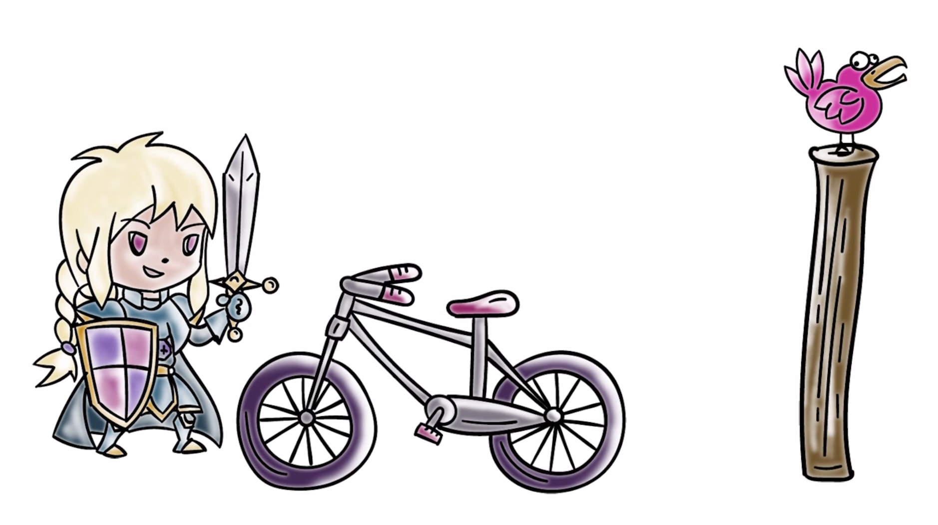
Vulnerabilities and Attacks
Time to
take a break!

Slide 10
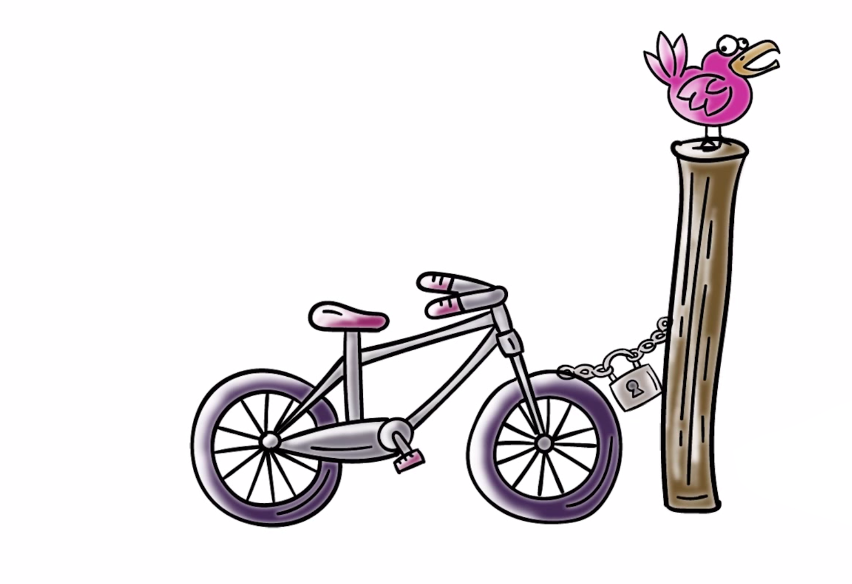
Vulnerabilities and Attacks

Slide 11
Vulnerabilities and Attacks
A few hours later...

Slide 12
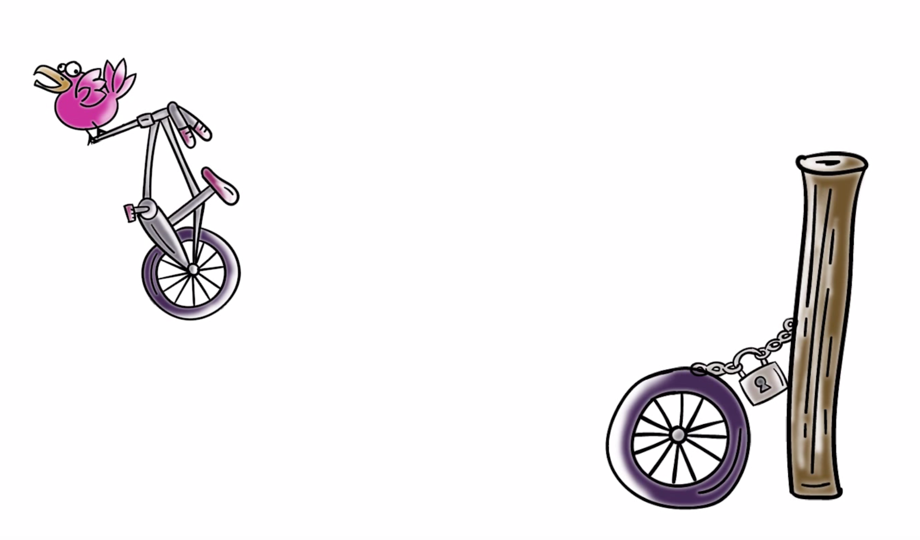
Vulnerabilities and Attacks
FAIL
Muahaha!

Slide 13
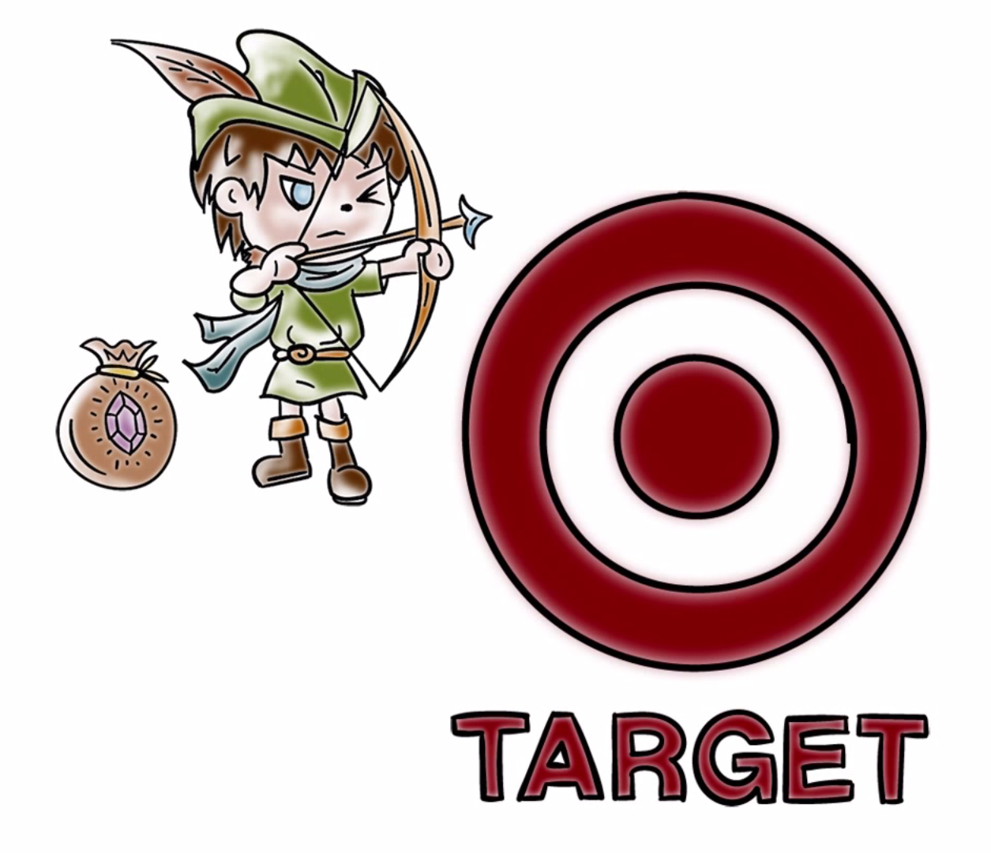
A Real World Example:

Slide 14
Black Market Prices Quiz
What is your hacked/stolen data worth on the Black Market (as of March 2015)? Enter dollar amounts in the boxes next to the data.
3 digit security code on your credit card
Credit card information
PayPal/Ebay account
Health information
Notes:
3-digit: $2
CC: $5-$45
Paypal: $27
Health: $10

Slide 15
Sony Pictures Quiz
With regards to the “The Interview” (2014) related hack, answer the following questions. Put the number of the correct answer in the box next to the question:
The threat source was:
[1] cybercriminals, [2] Hacktivists, or [3] Nation-State
Goal of the attack was:
[1] Monetize stolen information, [2] Stop Sony from releasing the movie “interview”), [3] Extort money from Sony
What did the attack accomplish:
[1] Disclosed sensitive data, [2] Destroyed Sony computers

Slide 16
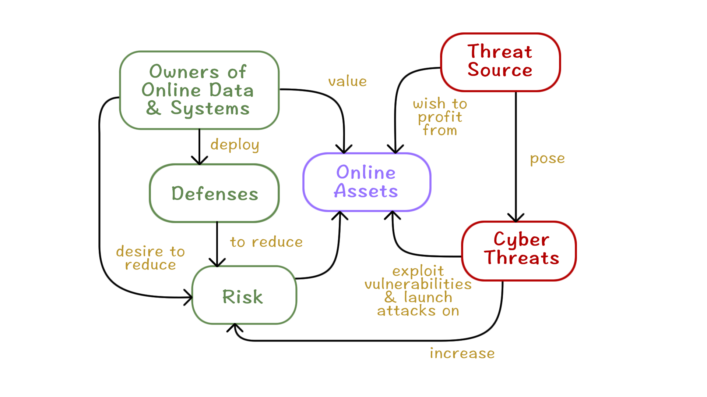
Revisiting Threats, Vulnerabilities, Attacks, and Risk
Relationship of Key Cyber Security Concepts

Slide 17
What Should We do in Cyber Security?
Make threats go away (crime should not pay)
Reduce vulnerabilities
Strive to meet security requirements of sensitive information:
Confidentiality
Integrity
Availability
Other consequences (stuxnet, physical)
CIA
(not the intelligence agency)

Slide 18

What should the Good Guys Do?
Prevention
Detection
Response
Recovery and remediation
Policy (what) vs. mechanism (how)

Slide 19

How Do We Address Cyber Security?
Reduce vulnerabilities by following basic design principles for secure systems:
Complexity is the enemy (economy of mechanism)
Fail-safe defaults
Complete mediation
Open Design
Least Privilege
Psychological acceptability
......

Slide 20
Mindset Quiz #1
What is the estimated value of world-wide losses due to cybercrime?
Less than $10 Billion (US)
Close to $500 Billion (US)
Trillions of US Dollars

Slide 21
Mindset Quiz #2
Data breaches violate which of the following security requirements?
Integrity
Availability
Confidentiality

Slide 22
Mindset Quiz #3
What security weakness was exploited to enable Stuxnet malware to compromise Iran's nuclear plan networks?
Out of date anti-virus system
Disloyal employees or poor judgment by humans
Weak security controls, such as easy to guess passwords

Slide 23
Security Mindset
Lesson Summary
Cyber Security:
HUGE problem for people, governments, companies, etc
Enhance the level of assurance of systems
Security mindset requires we know:
threats
actors/motivations
how they successfully attack

